Slide 1
Classifiers for Event Detection & Future Work
Kleisarchaki Sofia

Slide 2
Contents
Presentation of papers:
[1] – [6]
Events VS Non-Events
Definitions
Preconditions
Examples

Slide 3



[1]: “On-line New Event Detection and Tracking”
Feature extraction and query representation.(Inquery)
n most frequent single word features
Determine the query’s initial threshold by evaluating the new story with the query.
, where wi the relative weight of a query feature qi
di = belief(qi, d, c) = 0.4+0.6*tf*idf
t: #of times feature qi occurs in the doc
df: #of docs containing feature qi
dl: document’s length
avg_dl: avg doc’s length in the collection
|c|: #of docs in the collection
Documents/
Streams
Classifier
Ranker
Presentation

Slide 4
[1]: “On-line New Event Detection and Tracking”
If eval(q, d) > thresh then new event. Else, no new event.
p: constant percentage of the initial threshold
tp: time penalty
i-j: distance of the documents i and j (documents closer together on the stream are more likely to discuss related events)
Unable to detect events that are discussed in the news at different level of granularity.
i.e. “O.J. Simpson trial” vs other court cases
Solution: different weight strategy for query features
Documents/
Streams
Classifier
Ranker
Presentation

Slide 5
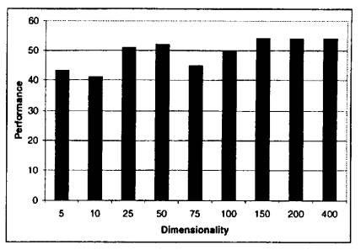
[1]: “On-line New Event Detection and Tracking”
Increasing the number of features results in improved performance, with an unacceptable increase in running time of the system.
Performance=100-distance from origin
Documents/
Streams
Classifier
Ranker
Presentation

Slide 6
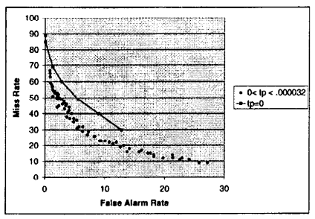
[1]: “On-line New Event Detection and Tracking”
Effects of varying threshold parameters p and tp.
On average, for any value of p, performance is better when tp>0.
Documents/
Streams
Classifier
Ranker
Presentation

Slide 7


[2]: “A system for New Event Detection”
Incremental Model (df: not static)
Nt: total number of documents at time t.
dfCt : denotes the document frequencies in the newly added set of documents Ct.
New events introduce new vocabulary
Low frequency terms w tends to be uninformative.
dft >= θd (θd=2)
Documents/
Streams
Classifier
Ranker
Presentation

Slide 8

[2]: “A system for New Event Detection”
Similarity Calculation between documents d, q
Making a decision- Identify document d*:
Score(q) > θs→ new event
Documents/
Streams
Classifier
Ranker
Presentation

Slide 9

[2]: “A system for New Event Detection”
Improvements
Source-Specific TF-IDF Model - dfs,t(w)
Document Similarity Normalization
Source-Pair Specific On-Topic Similarity Normalization
Using Inverse Event Frequencies of Terms – ef(w)
Documents/
Streams
Classifier
Ranker
Presentation

Slide 10

[3]: “Text Classification and Named Entities for New Event Detection”
Basic Model
weight(w, d) = tf ∗ idf
tf = log(termfrequecy + 1.0)
idf = log((docCount + 1)/(documentfreq + 0.5))
Basic Model can make mistakes → look into other parameters (category, overlap of named entities etc)
Documents/
Streams
Classifier
Ranker
Presentation

Slide 11
[3]: “Text Classification and Named Entities for New Event Detection”
Some categories:
Elections
Scandals/Hearings
Legal/Criminal Cases
Natural Disasters
Accidents
Acts of Violence or War
Three vector representations
α: all terms in the document
β: named entities (Language, location, nationality, organization etc)
γ: the non-named entity terms
Documents/
Streams
Classifier
Ranker
Presentation

Slide 12
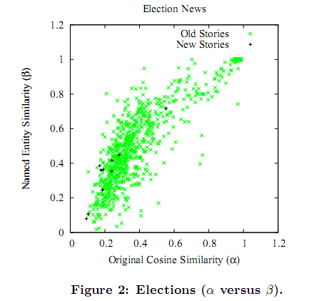
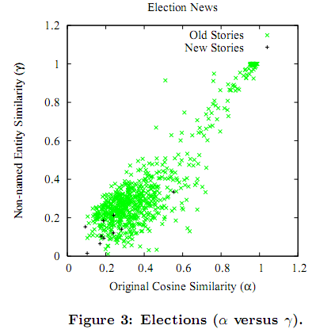
[3]: “Text Classification and Named Entities for New Event Detection”
Named entities are a double-edged sword and deciding when to use them can be tricky.
Considering named entities or not can not be decided for all categories.
Documents/
Streams
Classifier
Named Entities do not matter
Ranker
Presentation

Slide 13
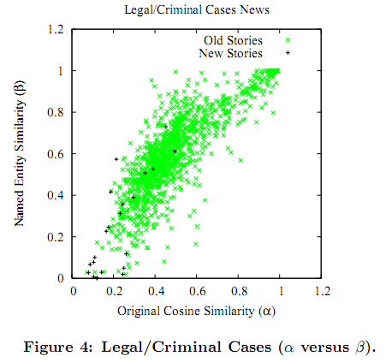
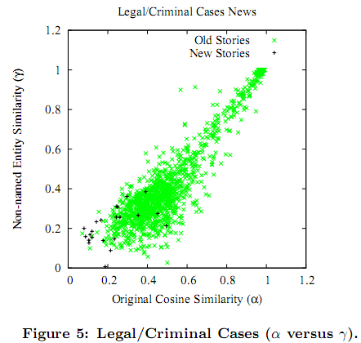
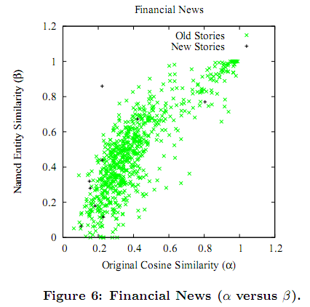
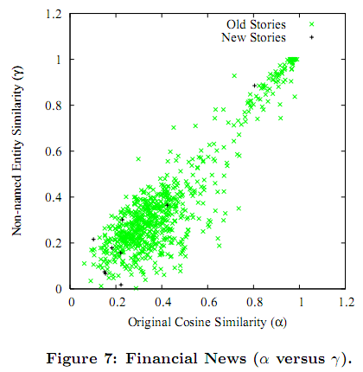
[3]: “Text Classification and Named Entities for New Event Detection”
Named Entities Win
Documents/
Streams
Classifier
Can not decide
Ranker
Presentation

Slide 14
[4]: “Streaming First Story Detection with application to Twitter”
Algorithm on locality-based sensitivity (constant time & space)
LSH-based approach
Constant number of documents inside the buckets.
Oldest document is removed
Constant number of comparisons
Compare each document with at most 3L documents it collided with.
We take the 3L most popular documents, according to the number of hash tables where the collision occurred.
Documents/
Streams
Classifier
Ranker
Presentation

Slide 15
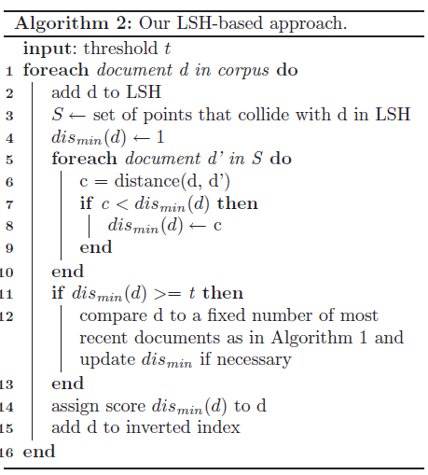
[4]: “Streaming First Story Detection with application to Twitter”
Documents/
Streams
Classifier
Ranker
Presentation

Slide 16
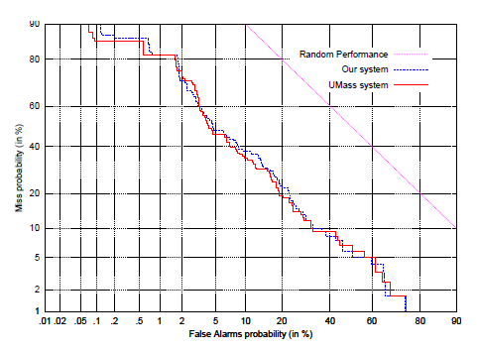
[4]: “Streaming First Story Detection with application to Twitter”
Minimal normalized scores:
Umass: 0.69 (28 hours)
LSH: 0.71 (2 hours)
Documents/
Streams
Classifier
Ranker
Presentation

Slide 17
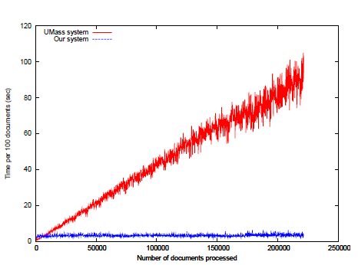
[4]: “Streaming First Story Detection with application to Twitter”
Comparison of processing time per 100 documents for LSH system and the Umass system.
Documents/
Streams
Classifier
Ranker
Presentation

Slide 18
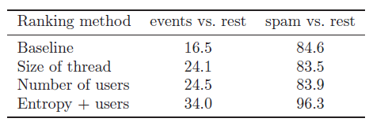

[4]: “Streaming First Story Detection with application to Twitter”
Average Precision for Events vs Rest (Neutral, Spam) and for Events and Neutral vs Spam.
Average Precision as a function of the entropy threshold on the Events vs Rest task.
Documents/
Streams
Classifier
Ranker
Presentation

Slide 19
[5]: “Learning Similarity Metrics for Event Identification in Social Media”
Similarity metrics for:
Textual Features
Cosine Similarity [3]
Time/Date
1-|t1-t2| / y,
y: number of minutes in a year
Location
1-H(L1, L2)
L1, L2: latitude-longitude pairs
H: Haversine distance
[The haversine formula is an equation important in navigation, giving great-circle distances between two points on a sphere from their longitudes and latitudes]
Documents/
Streams
Classifier
Ranker
Presentation

Slide 20


[5]: “Learning Similarity Metrics for Event Identification in Social Media”
Clustering Framework
Single pass incremental clustering algorithm with a threshold parameter.
Threshold Selection
Select the threshold with the highest combined NMI and B-Cubed value.
Where C={c1, .., cn}: set of clusters
E = {e1, .., en}: set of events
Pb: avg precision, Rb: avg recall
Documents/
Streams
Classifier
Ranker
Presentation

Slide 21
[5]: “Learning Similarity Metrics for Event Identification in Social Media”
Clusterer’s Weight Selection
Assign a weight during the supervised training phase, indicating our confidence in its prediction.
wc = combined(NMI, B-Cubed) / Σwi
Consensus score:
P: prediction function. Returns 1 if documents are in the same cluster, 0 otherwise.
Simple Ensemble based technique
Compute similarity of a document with a cluster by comparing the document against all documents in the cluster using the ensemble consensus function.
Documents/
Streams
Classifier
Ranker
Presentation

Slide 22
[5]: “Learning Similarity Metrics for Event Identification in Social Media”
Improved Ensemble based technique (centroid-based)
if σc(di, cj) > μc then
Pc(di, Cj) = 1
Else
Pc(di, Cj) = 0
Compute consensus-score(di, cj) = , where wc weight of clusterer
Textual Centroid
Avg(tf*idf) per term
Time Centroid
Avg(time) in minutes
Location Centroid
Geographic mid-point
Documents/
Streams
Classifier
Ranker
Presentation

Slide 23


[6]: “Temporal and Information Flow Based Event Detection From Social Text Streams”
Collection of social text stream data:
D = <(p1, t1, s1), .., (pn, tn, sn)>
pi ε P = {p1, .., p|p| }: piece of text content
ti : timestamp
si = <ai, ri> :social actor (initial actor→receiver)
Modelled as a graph, where each node is a text piece and each edge is the similarities between text pieces.
Content Based Clustering
Temporal Intensity based segmentation
Information Flow Pattern
Event Definition & Detection Algorithm

Slide 24


[6]: “Temporal and Information Flow Based Event Detection From Social Text Streams”
Text pieces are clustered into different topics using the graph cut algorithm.
Minimize the function:
Shi & Malik, ‘Normalized cuts and Image Segmentation’
As a result each piece of text belongs to a topic cluster in the graph cut-based result.
Content Based Clustering
Temporal Intensity based segmentation
Information Flow Pattern
Event Definition & Detection Algorithm

Slide 25
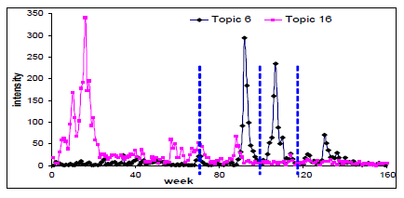
[6]: “Temporal and Information Flow Based Event Detection From Social Text Streams”
Intensity of a topic at a time window is defined as the total number of text pieces created within a time window under the corresponding topic.
Segment a sequence of intensities of a topic <i1, .., in> into a sequences of k intervals <I1, .., In> [9]
Content Based Clustering
Temporal Intensity based segmentation
Information Flow Pattern
Event Definition & Detection Algorithm

Slide 26
[6]: “Temporal and Information Flow Based Event Detection From Social Text Streams”
As a result from the temporal segmentation, each topic is represented as a sequence of social network graphs over the temporal dimension.
Nodes: actors
Edges: communication intensity of the corresponding social actors
Communication intensity:
number of communication text pieces between two social actors bi and bj under topic m within the nth time window.
Content Based Clustering
Temporal Intensity based segmentation
Information Flow Pattern
Event Definition & Detection Algorithm

Slide 27
[6]: “Temporal and Information Flow Based Event Detection From Social Text Streams”
Definition (Information Flow Chart): Given two social actors bi and bj , for a given topic m, the information flow pattern between them, denoted as Fm(bi, bj ), is defined as a vector of communication intensities.
Compute similarity between flow patterns using the dynamic time warping concept [10]
Content Based Clustering
Temporal Intensity based segmentation
Information Flow Pattern
Event Definition & Detection Algorithm

Slide 28
[6]: “Temporal and Information Flow Based Event Detection From Social Text Streams”
Definition (Event): Given a social text stream corpus denoted as D = <(p1, t1, s1), (p2, t2, s2), .., (pn, tn, sn) >, an event is defined as a subset of triples M = {(pi, ti, si), (pi+1, ti+1, si+1), ..., (pl, tl, sl) } such that:
(1) for every pi, pj ε PM= {pi, pi+1, .., p|M|} belongs to the same topic cluster based on the content-based text clustering results;
(2) any timestamp in <ti, ti+1... Tj> is within the same time interval In, which is one of the time segments in the temporal intensity-based segmentation results; and
(3) each pair of social actors st ε SM = {si, si+1... sl} belongs to the same cluster among the graph cut results on the dual graph of the information flow pattern based graph.
Content Based Clustering
Temporal Intensity based segmentation
Information Flow Pattern
Event Definition & Detection Algorithm

Slide 29
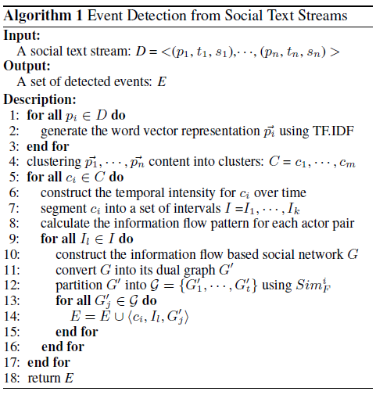
[6]: “Temporal and Information Flow Based Event Detection From Social Text Streams”
Content Based Clustering
Temporal Intensity based segmentation
Information Flow Pattern
Event Definition & Detection Algorithm

Slide 30
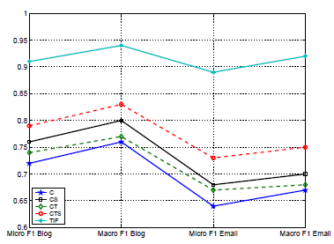
[6]: “Temporal and Information Flow Based Event Detection From Social Text Streams”
C: content based E.D
CT content and temporal based E.D
CS content and social based E.D
CTS content, temporal, and social based E.D
TIF temporal & information flow pattern based E.D
Content Based Clustering
Temporal Intensity based segmentation
Information Flow Pattern
Event Definition & Detection Algorithm

Slide 31
Events VS non-Events
Current papers focus on event documents.
Learn to distinguish documents that contain an event from non-event documents.

Slide 32
Events VS non-Events
Event Definitions:
An event is something that occurs in a certain place at a certain time.
A tweet can labelled as an event, if it is clear from the tweet alone what exactly has happened without any prior knowledge of the event and the event referenced in the tweet has to be sufficiently important. [4]
Informative
Important

Slide 33
Events VS non-Events
Event Pre-Conditions:
Informative
A tweet is informative when it contains information (directly or indirectly) about what, when and where something happened and which where the actors of the event.
Subject, time, place, actors
Important (celebrity deaths, natural disasters, major sports, political, entertainment, plane crashes and other disasters)
Some indicators of importance are:
The growth rate of unique users talking about the event.
The influence of the users.
The dissemination of the information.

Slide 34
Events VS non-Events
Indicators of Importance:
Growth rate of users

Slide 35
Events VS non-Events
Indicators of Importance:
Influence of the user
A user with many followers represents a strongly authoritative twitter user that he/she can influence the text stream activity of many other users.
The influence of a user can be calculated using PageRank algorithm [7]

Slide 36
Events VS non-Events
Indicators of Importance:
The dissemination of the information
Events that influence many people are/tend to be important.
On the other hand locality-proximity is an
indication of documents
dissimilarity in the
presence of all other
features (text, time etc)
[5]

Slide 37
Events VS non-Events
Non Event Definitions:
A non-event is the non-occurrence of an event. [8]
A non-event is an anticipated or highly publicized event that either does not occur or turns out to be anticlimactic, boring, or a hoax. Non-events are disappointing because they are often hyped prior to their occurrence. [wikipedia]
A tweet can be characterized as non-event tweet if it does not obey the preconditions 1 and 2.

Slide 38
Events VS non-Events
Consider the examples below:
The growth rate of users talking about Christmas is increasing. Many tweets ,containing wishes about Christmas, arrive during December.
Preconditions:1 is not valid, 2 is valid →non Event
A local festival (Heraklion city) is taking place on 11th of December.
Preconditions:1 is valid, 2 is not valid →non Event

Slide 39
Events VS non-Events
Non-Event tweets contain:
Spam Tweets
Advertisements, automatic weather updates, automatic radio station updates etc.
Entropy is a good metric for detecting spam tweets, as they contain very little information. [4]
Neutral Tweets
Any tweet that is not event or spam tweet.

Slide 40
Events VS non-Events
Davidson’s criterion of identity: two events are identical when they have the same causes and effects.
Non-events fail to give satisfactory results. Even though two non-events may have exactly the same set of causes and results, they do not seem always to be identical to one another.
[8]

Slide 41
References
[1]: On-line New Event Detection and Tracking, 1998
[2]: A system for New Event Detection, 2003
[3]: Text Classification and Named Entities for New Event Detection, 2004
[4]: Streaming First Story Detection with application to Twitter, 2010
[5]: Learning Similarity Metrics for Event Identification in Social Media, 2010
[6]: Temporal and Information Flow Based Event Detection From Social Text Streams, 2007
[7]: Emerging Topic Detection on Twitter based on Temporal and Social Terms Evaluation
[8]: Non-Events
[9]: A better Alternative to piecewise linear time series segmentation, 2007
[10]: Exact indexing of dynamic time warping, 2002

